Slide 1

Lecture 2.4 – Introduction to CUDA C
GPU Teaching Kit
Accelerated Computing
Introduction to the CUDA Toolkit

Slide 2
Objective
To become familiar with some valuable tools and resources from the CUDA Toolkit
Compiler flags
Debuggers
Profilers

Slide 3
GPU Programming Languages
Numerical analytics
MATLAB, Mathematica, LabVIEW
Fortran
CUDA Fortran
C
CUDA C
C++
CUDA C++
Python
PyCUDA, Copperhead, Numba, NumbaPro
F#
Alea.cuBase
Notes:
In this presentation I will talk about a variety of available GPU programming languages and interfaces. The languages include C, C++, C#, Fortran, Python, and numerical analytics packages such as MATLAB, Mathematica, and LabVIEW.

Slide 4
CUDA - C
Applications
Libraries
Compiler Directives
Programming Languages
Easy to use
Most Performance
Easy to use
Portable code
Most Performance
Most Flexibility

Slide 5
NVCC Compiler
NVIDIA provides a CUDA-C compiler
nvcc
NVCC compiles device code then forwards code on to the host compiler (e.g. g++)
Can be used to compile & link host only applications

Slide 6
Example 1: Hello World
int main() {
printf("Hello World!\n");
return 0;
}
Instructions:
Build and run the hello world code
Modify Makefile to use nvcc instead of g++
Rebuild and run

Slide 7
CUDA Example 1: Hello World
__global__ void mykernel(void) {
}
int main(void) {
mykernel<<<1,1>>>();
printf("Hello World!\n");
return 0;
}
Instructions:
Add kernel and kernel launch to main.cu
Try to build

Slide 8
CUDA Example 1: Build Considerations
Build failed
Nvcc only parses .cu files for CUDA
Fixes:
Rename main.cc to main.cu
OR
nvcc –x cu
Treat all input files as .cu files
Instructions:
Rename main.cc to main.cu
Rebuild and Run

Slide 9
Hello World! with Device Code
__global__ void mykernel(void) {
}
int main(void) {
mykernel<<<1,1>>>();
printf("Hello World!\n");
return 0;
}
mykernel(does nothing, somewhat anticlimactic!)
Output:
$ nvcc main.cu
$ ./a.out
Hello World!

Slide 10


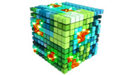


Developer Tools - Debuggers
NSIGHT
CUDA-GDB
CUDA MEMCHECK
NVIDIA Provided
3rd Party
https://developer.nvidia.com/debugging-solutions

Slide 11
Compiler Flags
Remember there are two compilers being used
NVCC: Device code
Host Compiler: C/C++ code
NVCC supports some host compiler flags
If flag is unsupported, use –Xcompiler to forward to host
e.g. –Xcompiler –fopenmp
Debugging Flags
-g: Include host debugging symbols
-G: Include device debugging symbols
-lineinfo: Include line information with symbols

Slide 12
CUDA-MEMCHECK
Memory debugging tool
No recompilation necessary
%> cuda-memcheck ./exe
Can detect the following errors
Memory leaks
Memory errors (OOB, misaligned access, illegal instruction, etc)
Race conditions
Illegal Barriers
Uninitialized Memory
For line numbers use the following compiler flags:
-Xcompiler -rdynamic -lineinfo
http://docs.nvidia.com/cuda/cuda-memcheck

Slide 13
Example 2: CUDA-MEMCHECK
Instructions:
Build & Run Example 2
Output should be the numbers 0-9
Do you get the correct results?
Run with cuda-memcheck
%> cuda-memcheck ./a.out
Add nvcc flags “–Xcompiler –rdynamic –lineinfo”
Rebuild & Run with cuda-memcheck
Fix the illegal write
http://docs.nvidia.com/cuda/cuda-memcheck

Slide 14
CUDA-GDB
cuda-gdb is an extension of GDB
Provides seamless debugging of CUDA and CPU code
Works on Linux and Macintosh
For a Windows debugger use NSIGHT Visual Studio Edition
http://docs.nvidia.com/cuda/cuda-gdb

Slide 15
Example 3: cuda-gdb
Instructions:
Run exercise 3 in cuda-gdb
%> cuda-gdb --args ./a.out
Run a few cuda-gdb commands:
(cuda-gdb) b main //set break point at main
(cuda-gdb) r //run application
(cuda-gdb) l //print line context
(cuda-gdb) b foo //break at kernel foo
(cuda-gdb) c //continue
(cuda-gdb) cuda thread //print current thread
(cuda-gdb) cuda thread 10 //switch to thread 10
(cuda-gdb) cuda block //print current block
(cuda-gdb) cuda block 1 //switch to block 1
(cuda-gdb) d //delete all break points
(cuda-gdb) set cuda memcheck on //turn on cuda memcheck
(cuda-gdb) r //run from the beginning
Fix Bug
http://docs.nvidia.com/cuda/cuda-gdb

Slide 16
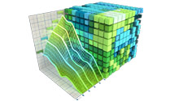
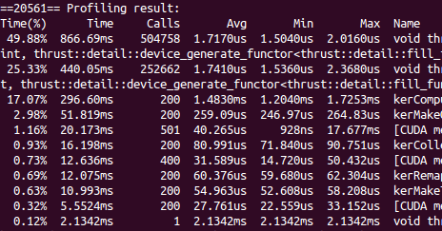


Developer Tools - Profilers
NSIGHT
NVVP
NVPROF
NVIDIA Provided
TAU
VampirTrace
3rd Party
https://developer.nvidia.com/performance-analysis-tools

Slide 17
NVPROF
Command Line Profiler
Compute time in each kernel
Compute memory transfer time
Collect metrics and events
Support complex process hierarchy's
Collect profiles for NVIDIA Visual Profiler
No need to recompile

Slide 18
Example 4: nvprof
Instructions:
Collect profile information for the matrix add example
%> nvprof ./a.out
How much faster is add_v2 than add_v1?
View available metrics
%> nvprof --query-metrics
View global load/store efficiency
%> nvprof --metrics gld_efficiency,gst_efficiency ./a.out
Store a timeline to load in NVVP
%> nvprof –o profile.timeline ./a.out
Store analysis metrics to load in NVVP
%> nvprof –o profile.metrics --analysis-metrics ./a.out

Slide 19
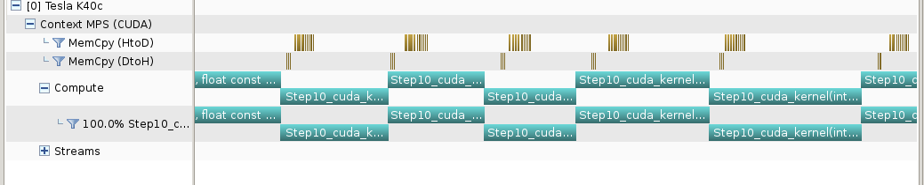
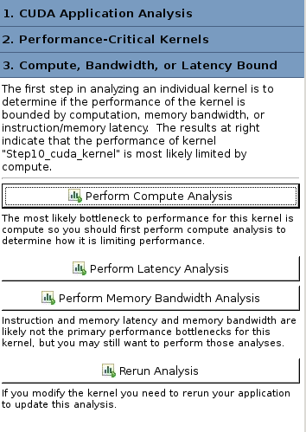
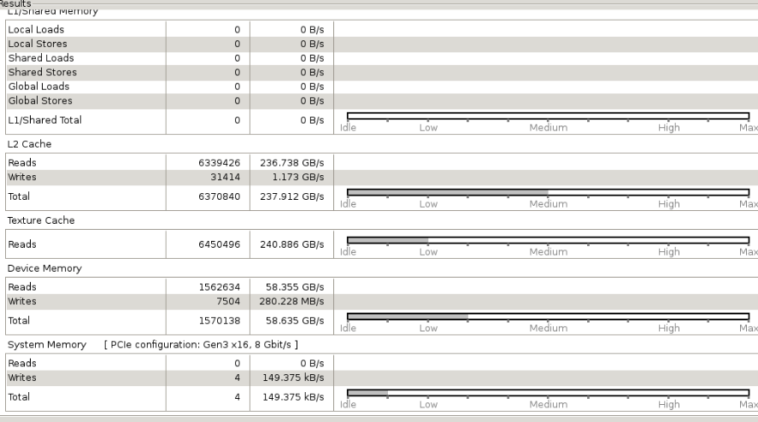
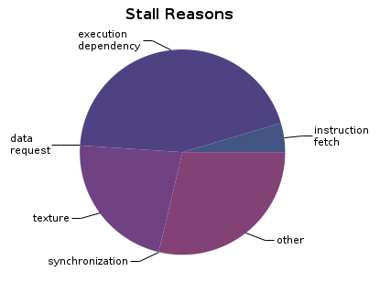
NVIDIA’s Visual Profiler (NVVP)
Timeline
Guided System
Analysis

Slide 20
Example 4: NVVP
Instructions:
Import nvprof profile into NVVP
Launch nvvp
Click File/ Import/ Nvprof/ Next/ Single process/ Next / Browse
Select profile.timeline
Add Metrics to timeline
Click on 2nd Browse
Select profile.metrics
Click Finish
Explore Timeline
Control + mouse drag in timeline to zoom in
Control + mouse drag in measure bar (on top) to measure time

Slide 21
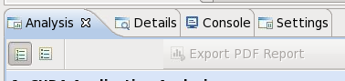
Example 4: NVVP
Instructions:
Click on a kernel
On Analysis tab click on the unguided analysis
Click Analyze All
Explore metrics and properties
What differences do you see between the two kernels?
Note:
If kernel order is non-deterministic you can only load the timeline or the metrics but not both.
If you load just metrics the timeline looks odd but metrics are correct.

Slide 22
Example 4: NVVP
Let’s now generate the same data within NVVP
Instructions:
Click File / New Session / Browse
Select Example 4/a.out
Click Next / Finish
Click on a kernel
Select Unguided Analysis
Click Analyze All

Slide 23
NVTX
Our current tools only profile API calls on the host
What if we want to understand better what the host is doing?
The NVTX library allows us to annotate profiles with ranges
Add: #include <nvToolsExt.h>
Link with: -lnvToolsExt
Mark the start of a range
nvtxRangePushA(“description”);
Mark the end of a range
nvtxRangePop();
Ranges are allowed to overlap
http://devblogs.nvidia.com/parallelforall/cuda-pro-tip-generate-custom-application-profile-timelines-nvtx/

Slide 24
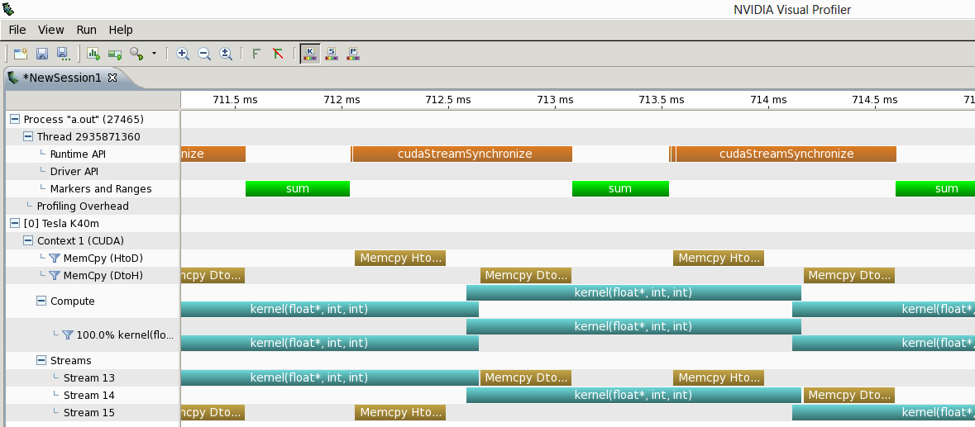
NVTX Profile

Slide 25
NSIGHT
CUDA enabled Integrated Development Environment
Source code editor: syntax highlighting, code refactoring, etc
Build Manger
Visual Debugger
Visual Profiler
Linux/Macintosh
Editor = Eclipse
Debugger = cuda-gdb with a visual wrapper
Profiler = NVVP
Windows
Integrates directly into Visual Studio
Profiler is NSIGHT VSE

Slide 26
Example 4: NSIGHT
Let’s import an existing Makefile project into NSIGHT
Instructions:
Run nsight
Select default workspace
Click File / New / Makefile Project With Existing CodeTest
Enter Project Name and select the Example15 directory
Click Finish
Right Click On Project / Properties / Run Settings / New / C++ Application
Browse for Example 4/a.out
In Project Explorer double click on main.cu and explore source
Click on the build icon
Click on the run icon
Click on the profile icon

Slide 27
Profiler Summary
Many profile tools are available
NVIDIA Provided
NVPROF: Command Line
NVVP: Visual profiler
NSIGHT: IDE (Visual Studio and Eclipse)
3rd Party
TAU
VAMPIR

Slide 28
Optimization
Assess
Optimize
Deploy
Parallelize

Slide 29
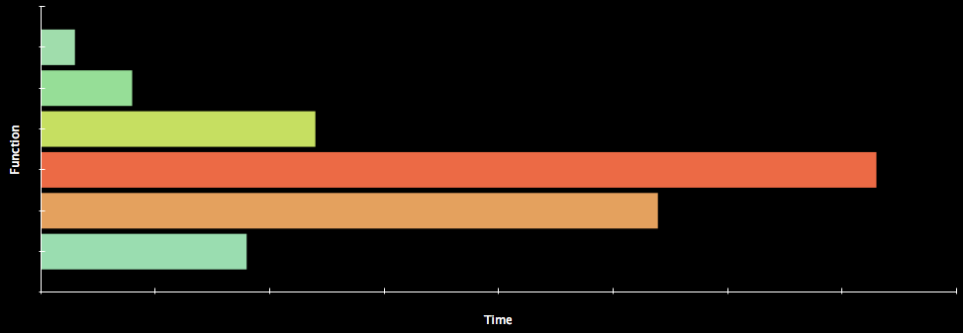
Assess
HOTSPOTS
Profile the code, find the hotspot(s)
Focus your attention where it will give the most benefit

Slide 30
Parallelize
Applications
Libraries
Compiler Directives
Programming Languages

Slide 31
Optimize
Timeline
Guided System
Analysis

Slide 32
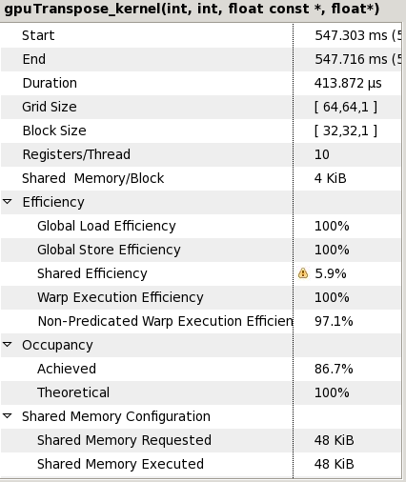
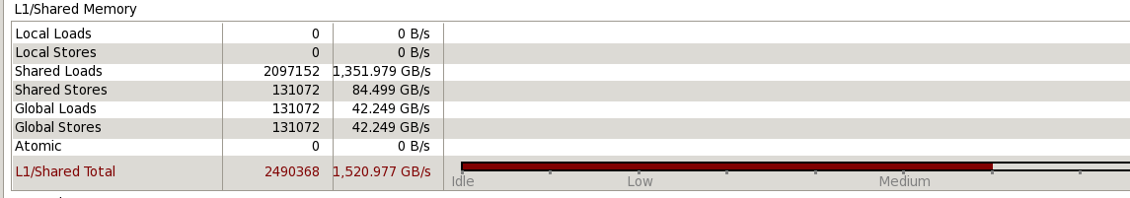
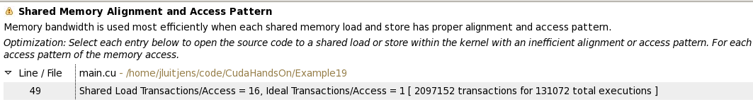
Bottleneck Analysis
Don’t assume an optimization was wrong
Verify if it was wrong with the profiler
129 GB/s 84 GB/s

Slide 33
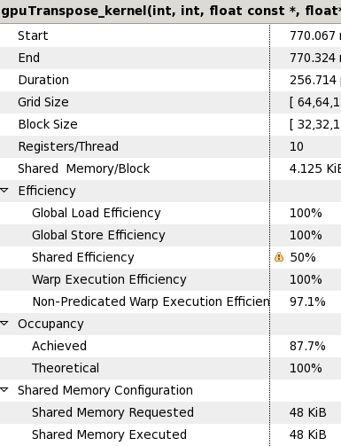
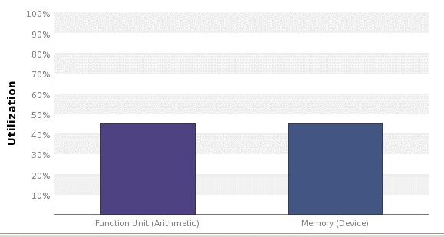
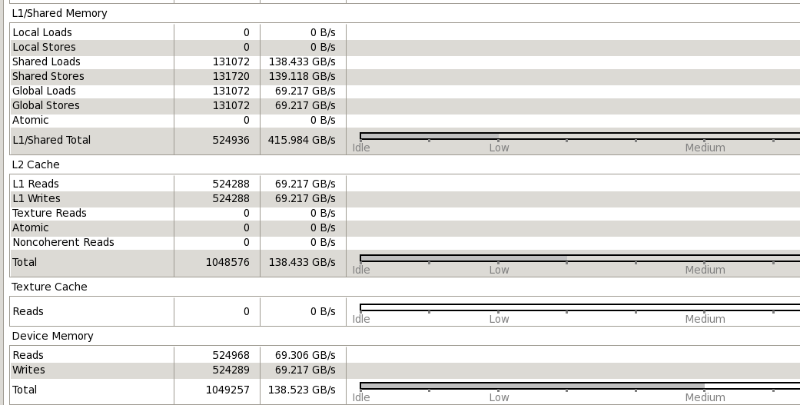
Performance Analysis
84 GB/s 137 GB/s

Slide 34
GPU Teaching Kit
The GPU Teaching Kit is licensed by NVIDIA and the University of Illinois under the Creative Commons Attribution-NonCommercial 4.0 International License.

